Slide 1

Translation Won’t Happen Without Dissemination and Implementation:
Some Measurement and Evaluation Issues
William M.K. Trochim
Presentation to the
3rd Annual NIH Conference on the Science of Dissemination and Implementation
Bethesda, MD
16 March 2010
This presentation contains draft results from studies that are still in progress. It may not be reproduced or distributed without written permission from the author.

Slide 2
Overview
Fundamental claims for translational research
Models of translational research (and how they depict dissemination and implementation)
The need for time-based process analyses to evaluate translational (and dissemination and implementation) research
Examples of time-based process evaluations
A call for time based process evaluation of dissemination and implementation research

Slide 3
Fundamental Claims for Translational Research
“Studies suggest that it takes an average of 17 years for research evidence to reach clinical practice.”
Balas, E. A., & Boren, S. A. (2000). Yearbook of Medical Informatics: Managing Clinical Knowledge for Health Care Improvement. Stuttgart, Germany: Schattauer Verlagsgesellschaft mbH.
“It takes an estimated average of 17 years for only 14% of new scientific discoveries to enter day-to-day clinical practice.”
Westfall, J. M., Mold, J., & Fagnan, L. (2007). Practice-based research - "Blue Highways" on the NIH roadmap. JAMA, 297(4), p. 403.
Notes:
For a claim as central as this one, it is surprisingly unclear.
If it takes 17 years for 14% of discoveries to enter practice, how long does it take for the remaining 86%?
What percentage of discoveries can be translated in ten years or fifteen years?
What is meant here by “scientific discovery” or by “day-to-day clinical practice” and how are these key concepts operationalized?

Slide 4
Balas & Boren, 2000 figure - Time
Rate
Time
Original Research
Negative
results
18%
(Dickersin, 1987)
variable
Submission
Negative
results
0.5 year (Kumar, 1992)
46%
(Koren, 1989)
Acceptance
0.6 year (Kumar, 1992)
Publication
Lack of Numbers
35%
(Balas, 1995)
0.3 year (Poyer, 1982)
Bibliographic Databases
Inconsistent
Indexing
50%
(Poynard, 1985)
6.0 – 13.0 years (Antman, 1992)
Review, Paper, Textbook
9.3 years (see Table II)
Redrawn from
Balas, E. A., & Boren, S. A. (2000). Yearbook of Medical Informatics: Managing Clinical Knowledge for Health Care Improvement. Stuttgart, Germany: Schattauer Verlagsgesellschaft mbH.
Implementation
Notes:
Note that they do not estimate how long it takes to conduct the research! They effectively start from when that research is submitted for publication.
The first four estimates of time are simply taken from published studies and added – although it’s important to note that the last of these uses the lower-bound estimate (6 years) of a fairly broad range (6-13 years).
The biggest part of their estimate is the 9.3 years they think it takes to move from a review, paper or textbook to implementation. This is a complex computation that requires us to look carefully at their Table II – next slide.

Slide 5
Balas & Boren, 2000, Table II
Clinical Procedure | Landmark Trial | Current Rate of Use
Flu Vaccination | 1968 (7) | 55% (8)
Thrombolytic therapy | 1971 (9) | 20% (10)
Pneumococcal vaccination | 1977 (11) | 35.6% (8)
Diabetic eye exam | 1981 (4) | 38.4% (6)
Beta blockers after MI | 1982 (12) | 61.9% (6)
Mammography | 1982 (13) | 70.4% (6)
Cholesterol screening | 1984 (14) | 65% (15)
Fecal occult blood test | 1986 (16) | 17% (17)
Diabetic foot care | 1983 (18) | 20% (19)
Review, Paper, Textbook
?
Implementation
Notes:
This table shows the nine landmark studies and the rate of use in the most “current” published study (which is indicated by the reference number immediately following the percent rate of use). To show how they calculated the annual increase in rate of use we need to figure out the year the use study (the reference) was published, subtract from that year the year in which the landmark study was published, and divide the rate by the number of years between publication and the rate use study. This gives the estimated annual increase in use for each study – see these calculations on the next slide.

Slide 6
Balas & Boren, 2000, Table II Calculations
Review, Paper, Textbook
?
Implementation
Notes:
For example, for the first landmark study on flu vaccination it took 29 years (1997-1968 = 29) to go from its publication to the rate of use study. The estimated rate of use in 1997 was 55%. That means that on average each year the use increased by 55/29 = 1.89% per year. To find the overall average increase in rate of use they simply averaged across the nine studies. We obtained an estimate of 3.149 which is only slightly off of their estimate of 3.2 (and we think is attributable to rounding error – they probably did not retain as many significant digits as we do).

Slide 7
Estimating time from review paper to use
Estimated annual increase in rate of use = 3.2%
Criterion for “use” = 50%
50% / 3.2% = 15.6 years from landmark publication to use
From other sources estimated 6.3 years from publication to inclusion in review, paper or textbook
So, to estimate the time from inclusion in a review, paper or textbook until 50% rate of use would be achieved they computed
  Review-to-Use = Publication-to-Use – Publication-to-Review
  Review-to-Use = 15.6 – 6.3 = 9.3 years
Review, Paper, Textbook
?
Implementation
Notes:
What is their justification for the standard of 50% use?
“Is 50 percent utilization rate an acceptable threshold for declaring success in the practical implementation of clinical recommendations? The problem of translating clinical research into clinical practice is not a new one. In 1989, an article in the New England Journal of Medicine asked the following question: “Do Practice Guidelines Guide Practice?” [29] The answer in the article was “no” and, obviously, more needs to be done to put well-substantiated recommendations into clinical practice.” (Balas and Boren , 2000, p. 66)

Slide 8
The 17 year calculation
Cumulative Total
Original Research
Submission
0.5 year
Acceptance
0.5 year
0.6 year
Publication
1.1 years
0.3 year
Bibliographic Databases
1.4 years
6.0
–
13.0 years
Review, Paper, Textbook
7.4 years
9.3 years
Implementation
16.7 years
~17 years

Slide 9
The 14% Calculation
100.00%
Original Research
Minus 18%
Negative
18%
results
(Dickersin, 1987)
82.00%
Submission
Negative
46%
Minus 46%
results
(Koren, 1989)
Acceptance
44.28%
Publication
Minus 35%
Lack of Numbers
35%
(Balas, 1995)
28.78%
Bibliographic Databases
Minus 50%
Inconsistent
50%
Indexing
(Poynard, 1985)
14.39%
Review, Paper, Textbook
Approximately 14% of original research studies survive to implementation.
Implementation

Slide 10
In Other Words…

Slide 11
Assessing the Translational Process Claims
The 17 year 14% survival estimate only covers part of the translational process
  It leaves out the entire basic-to-clinical research process
  It uses the criterion of 50% adoption for use
  It omits from use to health impacts
  The 14% figure does not include survival rates from basic through clinical research
These figures are almost certainly an
  underestimate of the time it takes to translate research to impacts
  overestimate of the percent of studies that survive to contribute to utilization
Even so, the largest segment of translational time in these estimates encompasses the region of dissemination and implementation

Slide 12
Models of Translational Research
Translational research emerged in part to address the “17 year” problem
Many definitions and models of translational research have been offered
Four are presented here and their relationship to dissemination and implementation highlighted

Slide 13
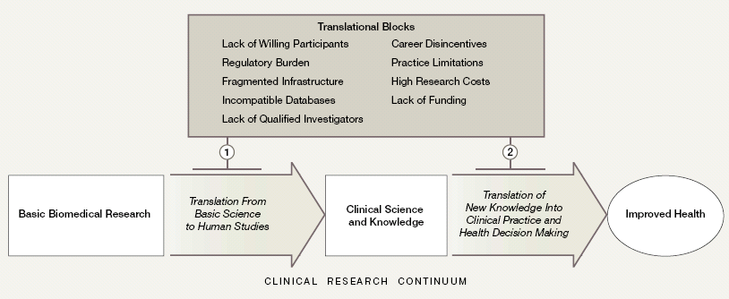
Sung et al, 2003
Sung, N. S., Crowley, W. F. J., Genel, M., Salber, P., Sandy, L., Sherwood, L. M., et al. (2003). Central Challenges Facing the National Clinical Research Enterprise. JAMA, 289(10), 1278-1287.
Notes:
All four assume feedback

Slide 14
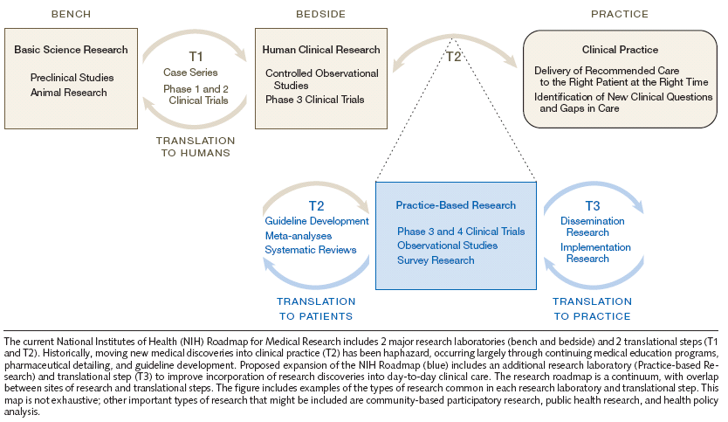
Westfall et al, 2007
Westfall, J. M., Mold, J., & Fagnan, L. (2007). Practice-based research - "Blue Highways" on the NIH roadmap. JAMA 297(4), 403-406.

Slide 15
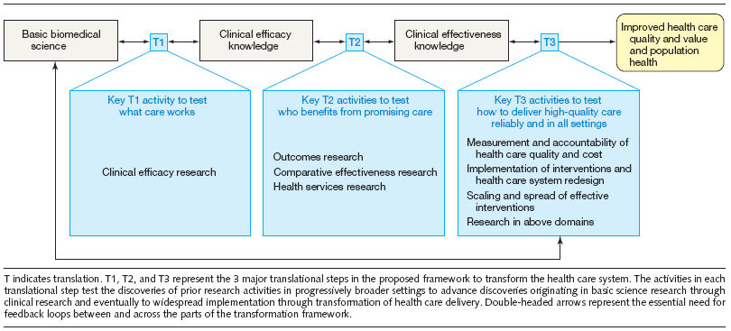
Dougherty & Conway, 2008
Dougherty, D., & Conway, P. H. (2008). The "3T's" Road Map to Transform US Health Care. JAMA, 299(19), 2319 - 2321.

Slide 16
Khoury et al, 2007
T1
From Gene Discovery to Health Application
T2
From Health Application to Evidence-Based Guideline
T3
From
Guideline to
Health
Practice
T4
From
Health
Practice to Impact
HuGE
Guideline
Development
Implementation
Dissemination
Diffusion
Research
Outcomes
Research
ACCE
Phase I
Phase II
Trials
Phase III
Trials
Phase IV
Trials
Khoury, M. J., Gwinn, M., Yoon, P. W., Dowling, N., Moore, C. A., & Bradley, L. (2007). The continuum of translation research in genomic medicine: how can we accelerate the appropriate integration of human genome discoveries into health care and disease prevention? Genetics in Medicine, 9(10), 665-674.

Slide 17
Synthesis of Translational Models
Basic Research
Clinical Research
Meta-Analyses,
Systematic Reviews,
Guidelines
Practice-Based Research
Health Impacts
T1
Basic Biomedical Research → Clinical Science and Knowledge
T2
Clinical Science and Knowledge →
Improved Health
Sung et al, 2003
T1
Bench →
Bedside
T2
Bedside →
Practice-Based Research
T3
Practice-Based Research →
Practice
Westfall et al, 2007
T3
Clinical Effectiveness Knowledge →
Improved Health Care Quality and Value and Population Health
T1
Basic Biomedical Science →
Clinical Efficacy Knowledge
T2
Clinical Efficacy Knowledge →
Clinical Effectiveness Knowledge
Dougherty & Conway, 2008
T1
Gene Discovery →
Health Application
T2
Health Application →
Evidence-based Guideline
T3
Guideline → Health Practice
T4
Practice →
Health Impact
Khoury et al, 2007
Dissemination and Implementation
from Trochim. Kane, Graham and Pincus (In progress.)

Slide 18


TRANSLATIONAL RESEARCH!!!”

Slide 19
Time Process Evaluations
Studies of the length of time (duration) needed to accomplish some segment of the translational research process
Requires operationalizing “marker” points
Should be done in conjunction with studies of
  Rates
  Costs
  Process Intervention Tests
    before and after studies of process interventions
    RCTs and quasi-experiments of process interventions

Slide 20
Examples of Time Process Evaluations
From pilot research application submission to award (CTSC)
From scientific idea to clinical trial (HIV/AIDS Clinical Research Networks)
From start to end of IRB & Contracts Processes (CTSAs)
From start to end of Clinical Research protocol (HIV/AIDS Clinical Research Networks)
From publication to research synthesis

Slide 21
Examples of Time Process Evaluations
Basic Research
Clinical Research
Meta-Analyses,
Syntheses,
Guidelines
Practice-Based Research
Health Impacts
T1
Basic Biomedical Research → Clinical Science and Knowledge
T2
Clinical Science and Knowledge →
Improved Health
Sung et al, 2003
T1
Bench →
Bedside
T2
Bedside →
Practice-Based Research
T3
Practice-Based Research →
Practice
Westfall et al, 2007
T3
Clinical Effectiveness Knowledge →
Improved Health Care Quality and Value and Population Health
T1
Basic Biomedical Science →
Clinical Efficacy Knowledge
T2
Clinical Efficacy Knowledge →
Clinical Effectiveness Knowledge
Dougherty & Conway, 2008
T1
Gene Discovery →
Health Application
T2
Health Application →
Evidence-based Guideline
T3
Guideline → Health Practice
T4
Practice →
Health Impact
Khoury et al, 2007

Slide 22
Pilot Grant Process (CTSC)
Research Proposal Process Analysis
133.5 days
GCRC
24 days
89.5 days
Date
Application
Initiated
Date
First
Submitted
For
Review
Date
Of
Final
Disposition
CTSC
6 days
57 days
67 days
0
20
40
60
80
100
120
140
Median Days

Slide 23
HIV/AIDS Clinical Trials Network Studies
The following examples illustrate the work being done under the direction of Jonathan Kagan, Division of Clinical Research, NIAID
These studies constitute one of the most ambitious efforts in time-based process evaluation and track the duration of processes that go continuously from
  Inception of a research idea (in an internal Scientific Research Committee review) → Pending status
  Pending Status → Open to Accrual
  Open to accrual → Closed to follow-up
Please note that this research is still in progress and has not yet been published. Because it is still under review, these results may be revised subsequently. Please do not cite or quote.

Slide 24
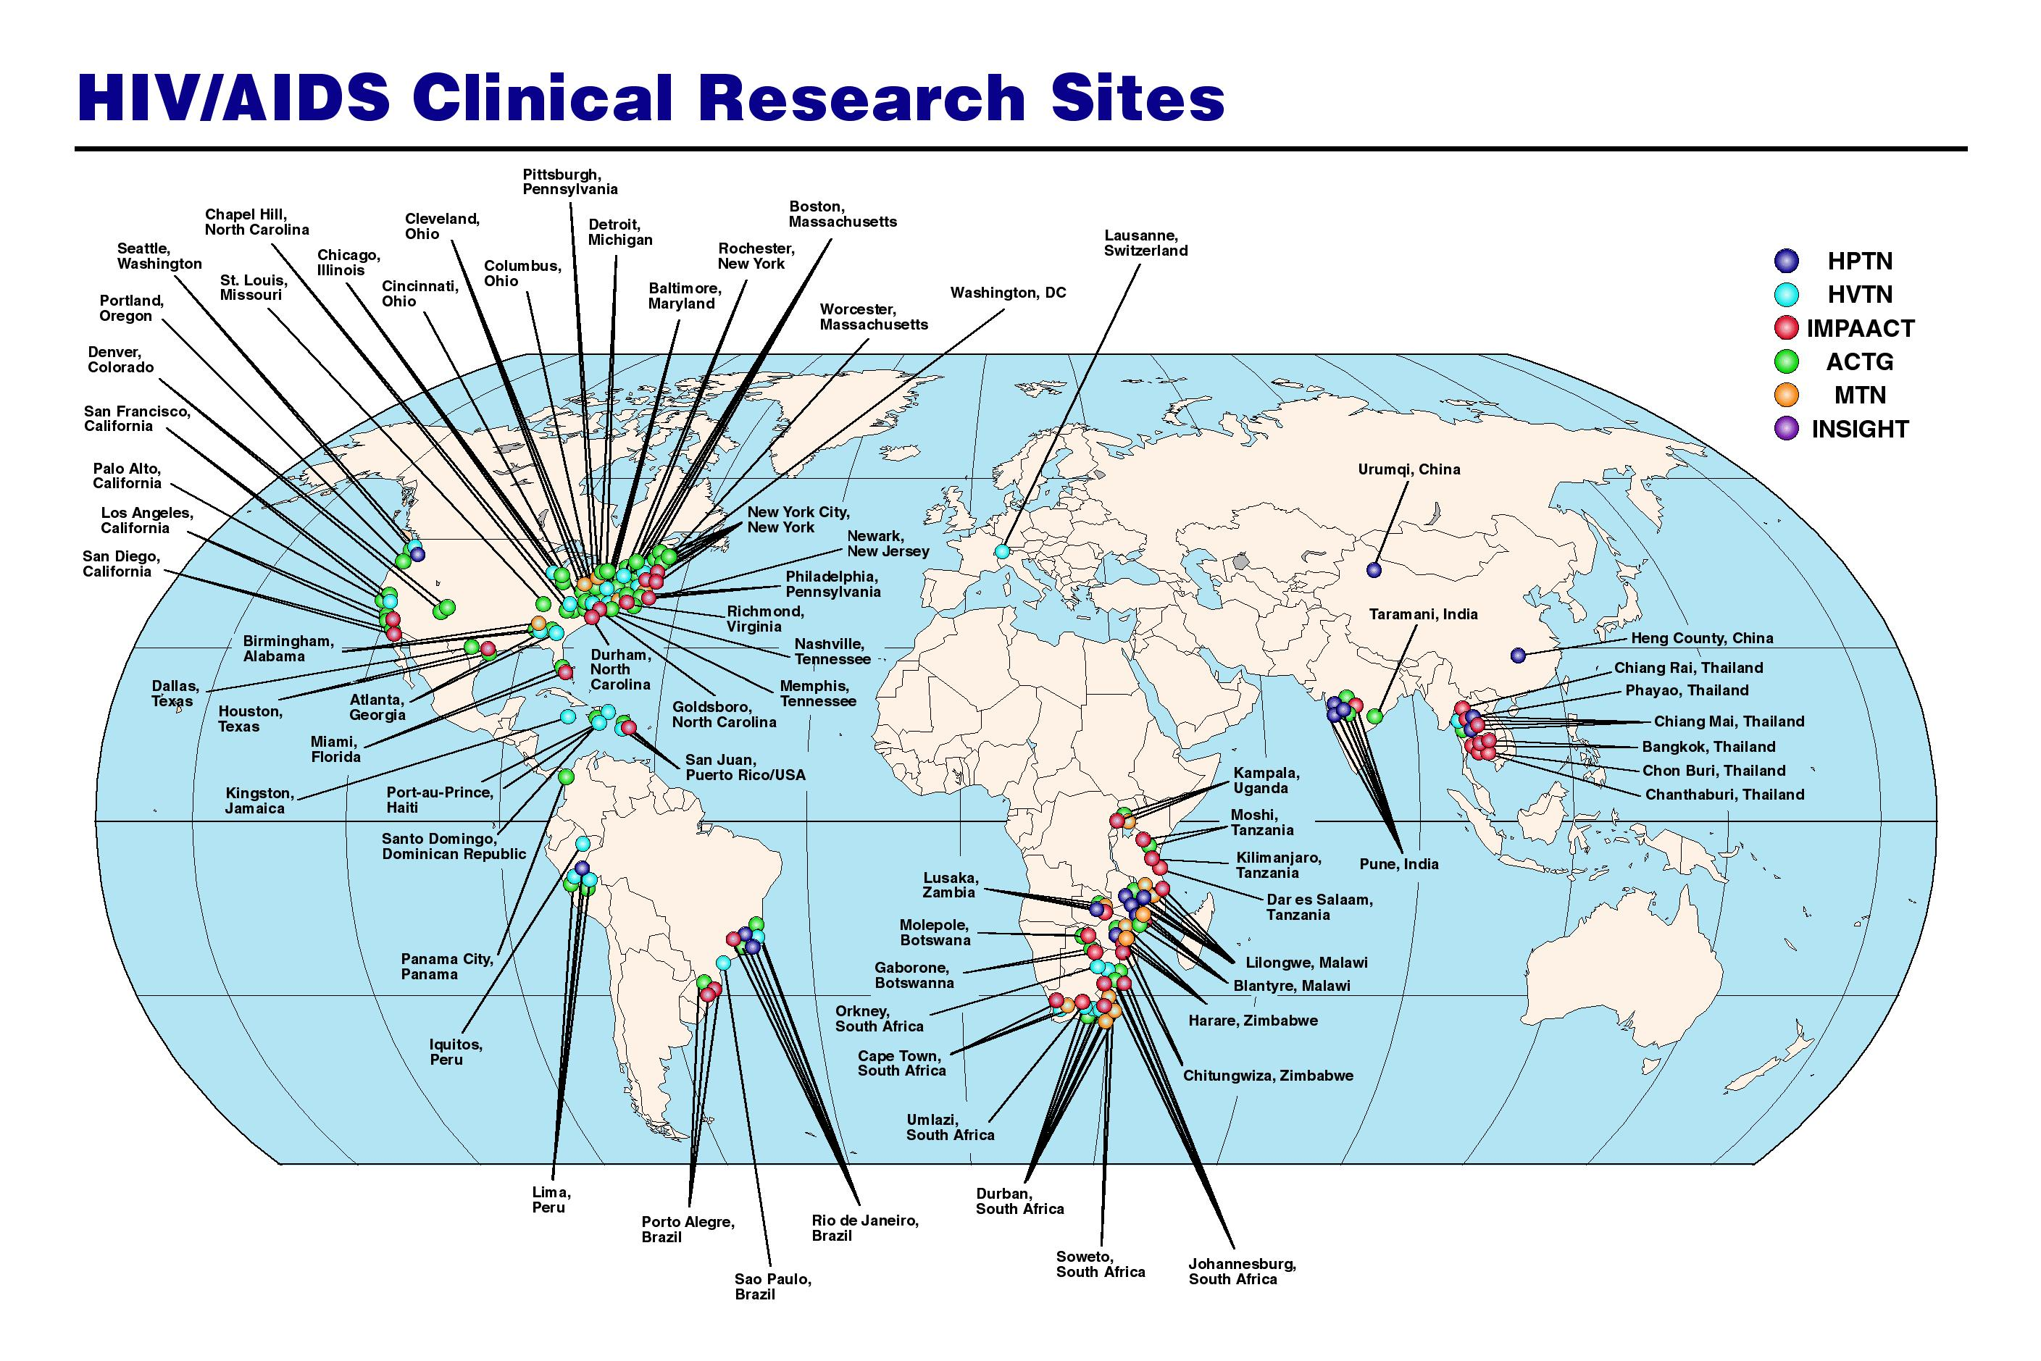
Kagan, J. and Trochim, W. (2009). Integrating Evaluation with Business Process Modeling for Increased Efficiency and Faster Results in HIV/AIDS Clinical Trials Research. Presentation at the Annual Conference of the American Evaluation Association, Orlando, Florida, November, 2009.

Slide 25
DAIDS Harmonized Protocol Statuses
Withdrawn
Proposed
In
Development
Pending
Open to
Accrual
Enrolling
Closed to
Accrual
Closed to
Follow Up
Participants Off Study
& Primary Analysis
Completed
Concluded
Archived
Kagan, J. and Trochim, W. (2009). Integrating Evaluation with Business Process Modeling for Increased Efficiency and Faster Results in HIV/AIDS Clinical Trials Research. Presentation at the Annual Conference of the American Evaluation Association, Orlando, Florida, November, 2009.

Slide 26
SRC Review Total Elapsed (Days¹)
Maximum¹ | 60
Minimum¹ | 1
Median¹ | 27
Target² | 35
Difference (Median-Target) | 2
Std. Deviation | 10.41
# of Reviews | 106
Note: The numbers shown above the bar represents the total number of days for SRC Review Process (A+B)
A= Days from Protocol Receipt to SRC Review
B= Days from SRC Review to Consensus Distribution
Kagan, J. and Trochim, W. (2009). Integrating Evaluation with Business Process Modeling for Increased Efficiency and Faster Results in HIV/AIDS Clinical Trials Research. Presentation at the Annual Conference of the American Evaluation Association, Orlando, Florida, November, 2009.
¹ Calendar days ² Business days

Slide 27
DAIDS Harmonized Protocol Statuses
Withdrawn
Proposed
In
Development
Pending
Open to
Accrual
Enrolling
Closed to
Accrual
Closed to
Follow Up
Participants Off Study
&
Primary Analysis
Completed
Concluded
Archived
Kagan, J. and Trochim, W. (2009). Integrating Evaluation with Business Process Modeling for Increased Efficiency and Faster Results in HIV/AIDS Clinical Trials Research. Presentation at the Annual Conference of the American Evaluation Association, Orlando, Florida, November, 2009.

Slide 28
Study Level
Pending
Open to
Accrual
Pending to Open to Accrual
Maximum # of Days | 468
Minimum # of Days | 43
Median | 125
# Of Protocols | 41
Standard Deviation | 120
Regulatory Requirements Met
Study Products Availability
DMC Requirements Met
RAB
Sign-Off
Protocol
Distributed
to Field
Open to
Accrual
Kagan, J. and Trochim, W. (2009). Integrating Evaluation with Business Process Modeling for Increased Efficiency and Faster Results in HIV/AIDS Clinical Trials Research. Presentation at the Annual Conference of the American Evaluation Association, Orlando, Florida, November, 2009.

Slide 29
Study Level
Open to Accrual to 1st Participant Enrollment
Maximum # of Days | 131
Minimum # of Days | 3
Median | 23
# Of Protocols | 34
Standard Deviation | 24
Regulatory Requirements Met
Study Products Availability
DMC Requirements Met
Protocol
Distributed
to Field
Open to
Accrual
1st Participant Enrolled
Kagan, J. and Trochim, W. (2009). Integrating Evaluation with Business Process Modeling for Increased Efficiency and Faster Results in HIV/AIDS Clinical Trials Research. Presentation at the Annual Conference of the American Evaluation Association, Orlando, Florida, November, 2009.

Slide 30
Days from Pending to v1.0 Site Registration (US Sites)
Pending to v1.0 Site Registration (US Sites)
Maximum of Averages | 972
Minimum of Averages | 72
Median of Averages | 160
# of Sites | 109
Standard Deviation | 152
Kagan, J. and Trochim, W. (2009). Integrating Evaluation with Business Process Modeling for Increased Efficiency and Faster Results in HIV/AIDS Clinical Trials Research. Presentation at the Annual Conference of the American Evaluation Association, Orlando, Florida, November, 2009.

Slide 31
Days from Pending to v1.0 Site Registration (Non-US Sites)
Pending to v1.0 Site Registration (Non-US Sites)
Maximum of Averages | 958
Minimum of Averages | 233
Median of Averages | 517
# of Sites | 36
Standard Deviation | 174
Kagan, J. and Trochim, W. (2009). Integrating Evaluation with Business Process Modeling for Increased Efficiency and Faster Results in HIV/AIDS Clinical Trials Research. Presentation at the Annual Conference of the American Evaluation Association, Orlando, Florida, November, 2009.

Slide 32
Protocol Timeline Summary
Receipt to Comments Distribution (single)
358 days
27 days
381 days
Receipt to Review (single)
15 days
233 days
133 days
Pending to Open to Accrual
Receipt to CSRC Review (Multiple)
100 days
SRC Review Completion to RAB Sign Off
125 days
23 days
Open to Accrual to Enrolling
160 days
Pending to v1.0 Site Registration (US Sites)
517 days
Pending to v1.0 Site Registration (Non-US Sites)
30
60
90
120
150
180
210
240
270
300
330
360
390
420
450
480
510
540
570
600
630
660
690
720
750
780
Days
Kagan, J. and Trochim, W. (2009). Integrating Evaluation with Business Process Modeling for Increased Efficiency and Faster Results in HIV/AIDS Clinical Trials Research. Presentation at the Annual Conference of the American Evaluation Association, Orlando, Florida, November, 2009.

Slide 33
The CTSA IRB & Contracts Pilots
Some caveats:
The following two examples describe research in progress that is being conducted under the auspices of the cross-national Strategic Goal #1 Committee of the Clinical and Translational Science Award (CTSA) centers.
These two examples are provided only to illustrate the idea of time-based process analyses and how they might look in real-world settings.
The primary intent of these pilots was to explore the feasibility of collecting such data and the potential interpretability and usefulness of results.
Across the CTSA sites there is considerable variability in the processes used in IRB reviews and contract negotiations. The centers agreed on the milestones described here for use in these pilot studies. Based on this initial work they are actively discussing methodological options for future work of this type.
The analysis is still in progress and has not yet been published, and consequently is still subject to review and potential revision.
Please do not quote or cite any results from this work.

Slide 34
CTSA IRB Study Design
Retrospective design
Institutional characteristics questions
Process questions
Metrics were collected on a maximum of 25 consecutive clinical trials that received IRB approval for a period of one calendar month. Studies were limited to initial protocols that received full board approvals during February 2009.
34 IRB sites at 33 CTSAs
425 protocols

Slide 35
IRB Results
4x = .7%
3x = 3.1%
2x = 16.2%
Number of IRB Reviews
Date
Application
Received
Date
Pre-Review
Change
Requests
Sent to PI
Date
PI
Resubmits
Pre-Review
Changes
Date of
First Full IRB
Review
Date
Post-Review
Change
Requests
Sent to PI
Date
PI
Resubmits
Post-Review
Changes
Date
Of Final
IRB
Approval
0
10
20
30
40
50
60
70
80
Durations
…
Median Days
Total
64
1
6
2
5
3
20
4
4
5
11
6
7
I
30
II
23

Slide 36
IRB Results
Median Total Duration by CTSA

Slide 37
IRB Results
Median Durations I & II by CTSA

Slide 38
CTSA Contracts Study Design
Prospective design
Inclusion Criteria: To be eligible for inclusion, a contract must have the following characteristics:
  The contract was assigned to a negotiator in the contracts negotiation office during the period of April 1, 2009, until May 31, 2009.
  The contract is among the first 25 contracts assigned to negotiators in the contracts office during the period of April 1, 2009, until May 31, 2009.
  The contract has an industry sponsor or a CRO contracted by the industry sponsor, as a party to the contract.
  The underlying study is a clinical trial.
  The underlying study has been developed by the industry sponsor or a CRO contracted by the industry sponsor.
  The underlying study is fully financially supported by the industry sponsor.
  The product being tested is a drug, biologic treatment, vaccine, or device.

Slide 39
Contracts Study Design
Milestones:
Negotiation
Start
Date
First
Comments
Provided
date
Negotiation
Finalized
date
Institution
Execution
Date
Full
Execution
date

Slide 40
From Publication to Meta-analysis
Used Cochrane Collaboration reports
Methods
  Extracted data from all active Cochrane reports (N= 3,190)
  The reports provide references for all publications (N= 61,193) whose data was used → extract year of each publication
  Duration = Cochrane report year – publication year
Can do for any research synthesis (meta-analysis, systematic review, guideline)

Slide 41
The Results (initial reviews; N=838 reports)
Median Number of Years from Publication to inclusion in an initial Cochrane Review =
8.0 years

Slide 42
What’s Next?
Dissemination and Implementation!

Slide 43
Conclusions
A call for time process evaluations in dissemination and implementation
  Especially from research synthesis to use
  Where are such studies? Please send to wmt1@cornell.edu
Evaluate effects of different types of dissemination and implementation interventions/strategies on durations
  Develop statistical methodologies (survival analysis, Kaplan-Meier; hierarchical linear regression)
Dissemination and Implementation durations will likely be among the longest in the translational research process
We won’t get translation without going through dissemination and implementation!
Dissemination and implementation researchers are engaged in the translational research enterprise as well

Slide 44
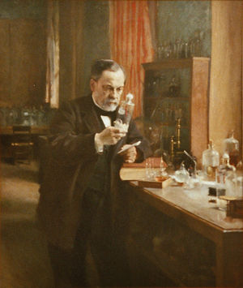
The Last Word
“To the individual who devotes his or her life to science, nothing can give more happiness than when results immediately find practical application. There are not two sciences. There is science and the application of science and these two are linked as the fruit is to the tree.”
Louis Pasteur

Slide 45
Acknowledgements
My thanks to the following funding sources which underwrote parts of this presentation:
  NIH/NIDA. A Collaborative Systems Approach for the Diffusion of Evidence-Based Prevention. NIH Grant #: R01 DA023437-01.
  National Science Foundation. A Phase II Trial of the Systems Evaluation Protocol for Assessing and Improving STEM Education Evaluation. DRL. NSF Grant #0814364.
  NIH/ NCRR. Institutional Clinical and Translational Science Award (U54). NIH Grant #: 1 UL1 RR024996-01.
  All the colleagues who contributed to the examples used here

